Slide 1
Synergy
Grow Your Worth
Notes:
Instructor:
Read through the whole lesson (including all the notes) before the day of class
Make note of and gather any supplies you need to bring (see Marshmallow Challenge, slide 20)
Prepare examples, stories
Think through how much time you want to spend on individual activities; make notes
Be sure to allow time to announce the assignment at the end
Overview:
Intro (slides 1-3): 2 minutes
Synergy (slides 4-23): 40-45 minutes
Conclusion (slides 24-26): 2-3 minutes
Total: 44-50 minutes

Slide 2
Review
Objectives:
Explore the importance of SMART goal-setting
Discussion motivation and how to harness ours
Notes:
Ask: What are “SMART” goals? Anyone accomplish a goal this week that they’d like to share?

Slide 3
Today
Objective:
Learn importance and application of principles of synergy

Slide 4
Synergy

Slide 5
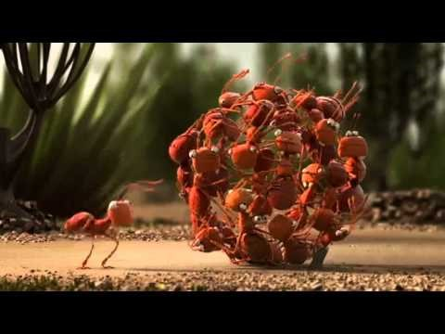
Notes:
This brief clip introduces the idea of synergy
Source: https://www.youtube.com/watch?v=w9j3-ghRjBs

Slide 6
Question
Who is Alan Turing,
and what did he do?

Slide 7

The Imitation Game
Notes:
Describe who Alan Turing is and what he did. (This is actually Benedict Cumberbatch, playing Turing in the movie The Imitation Game)
(Turing invented a machine to decrypt the German code “Enigma”, to find leverage in winning WWII.)
Source: https://onemoviefiveviews.files.wordpress.com/2015/01/810ajncvjpl-_sl1500_1.jpg

Slide 8
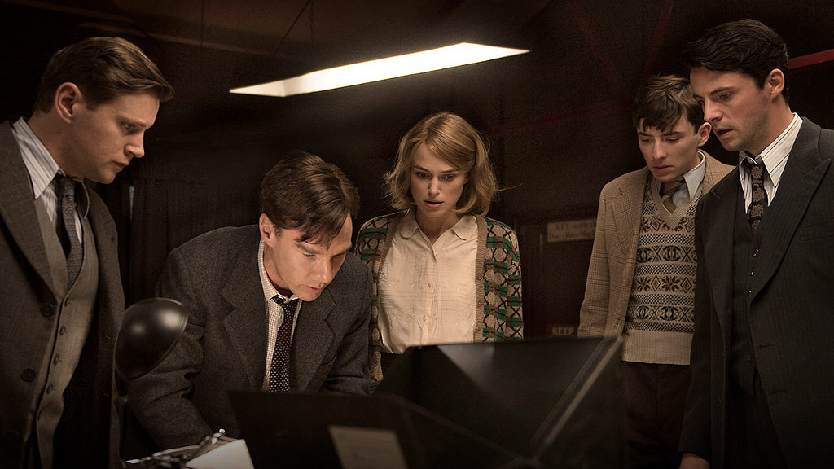
Alan Turing
Turing did a LOT of work on his own
Without his team and their resources, though, he could not have succeeded
Notes:
www.flickr.com

Slide 9

Synergy
Synergy is the power of groups, and the ability that groups have to get more done than the individuals would be able to do alone
In other words, “the whole is more than the sum of its parts” (Gestalt Philosophy)
Notes:
Image from www.hpocenter.com

Slide 10
Group Activity: Synergy
Time to put this into practice! Is synergy really more effective than just doing it yourself?
One student in class needs to volunteer to perform a task (that will be explained soon) separate from the group.
Notes:
(About 20 minutes: 10 to prepare, 10 for presentations)
Ask for a volunteer. You might want to pick the most brilliant, incredible, gifted student…whoever that is.

Slide 11
Task
Prepare a 3-5 minute presentation on the following topic:
“Describe the elements, assembly, and presentation of the best PB&J in history.”
Be as creative and dynamic as humanly possible.
Make this the most convincing presentation of your life.
Use every group member and all available resources as effectively as you can.
Ready? GO!!!
Notes:
Feel free to come up with a different presentation topic.
Give everyone about 10 minutes to prepare the presentation (one person working alone, and a group of everyone else. If the class is large, you could divide it into multiple groups)

Slide 12
Presentation
Play “Rock, Paper, Scissors” to decide who presents first
Then, give your 5 minute presentation.
Notes:
(5 minutes each)
Decide on a way to judge the presentations:
You could be the judge
The individual could judge the team, and vice versa
Everyone could judge everyone
(scores up to 5 stars or 10 points, or whatever)

Slide 13

Reflect & Discuss
What just happened?
Did you see synergy?
What did it look like?
What should it have looked like?
Notes:
Discuss in small groups or as a class.
Maybe the team worked really well together; maybe not.
Other questions for discussion:
Why do you like or dislike group work?
Share examples of when group work has been successful or unsuccessful. Why do you think the group did or didn’t work well together?
Image from startupstockphotos.com

Slide 14
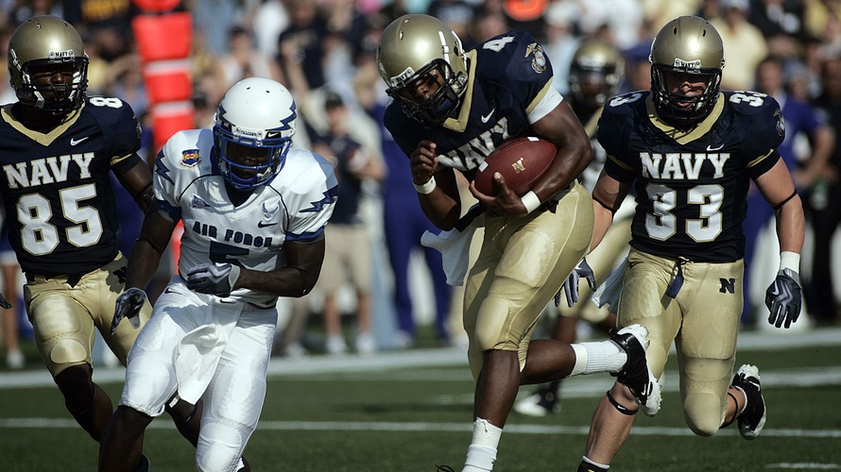
Reflect
To the individual: could you have used a few team members?
To the team: how could you have used your teammates more effectively?

Slide 15
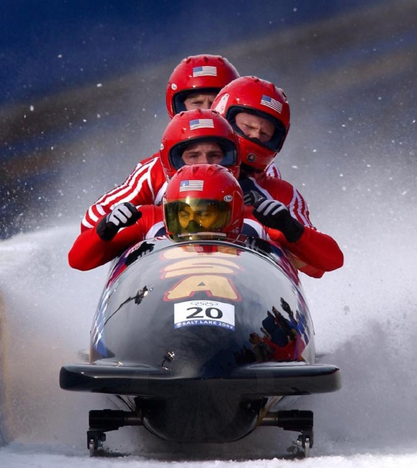
Synergy Principles
We may have made synergy look overly simplified during this class
Let’s discuss a few principles of synergy
Notes:
Image from pixabay.com

Slide 16
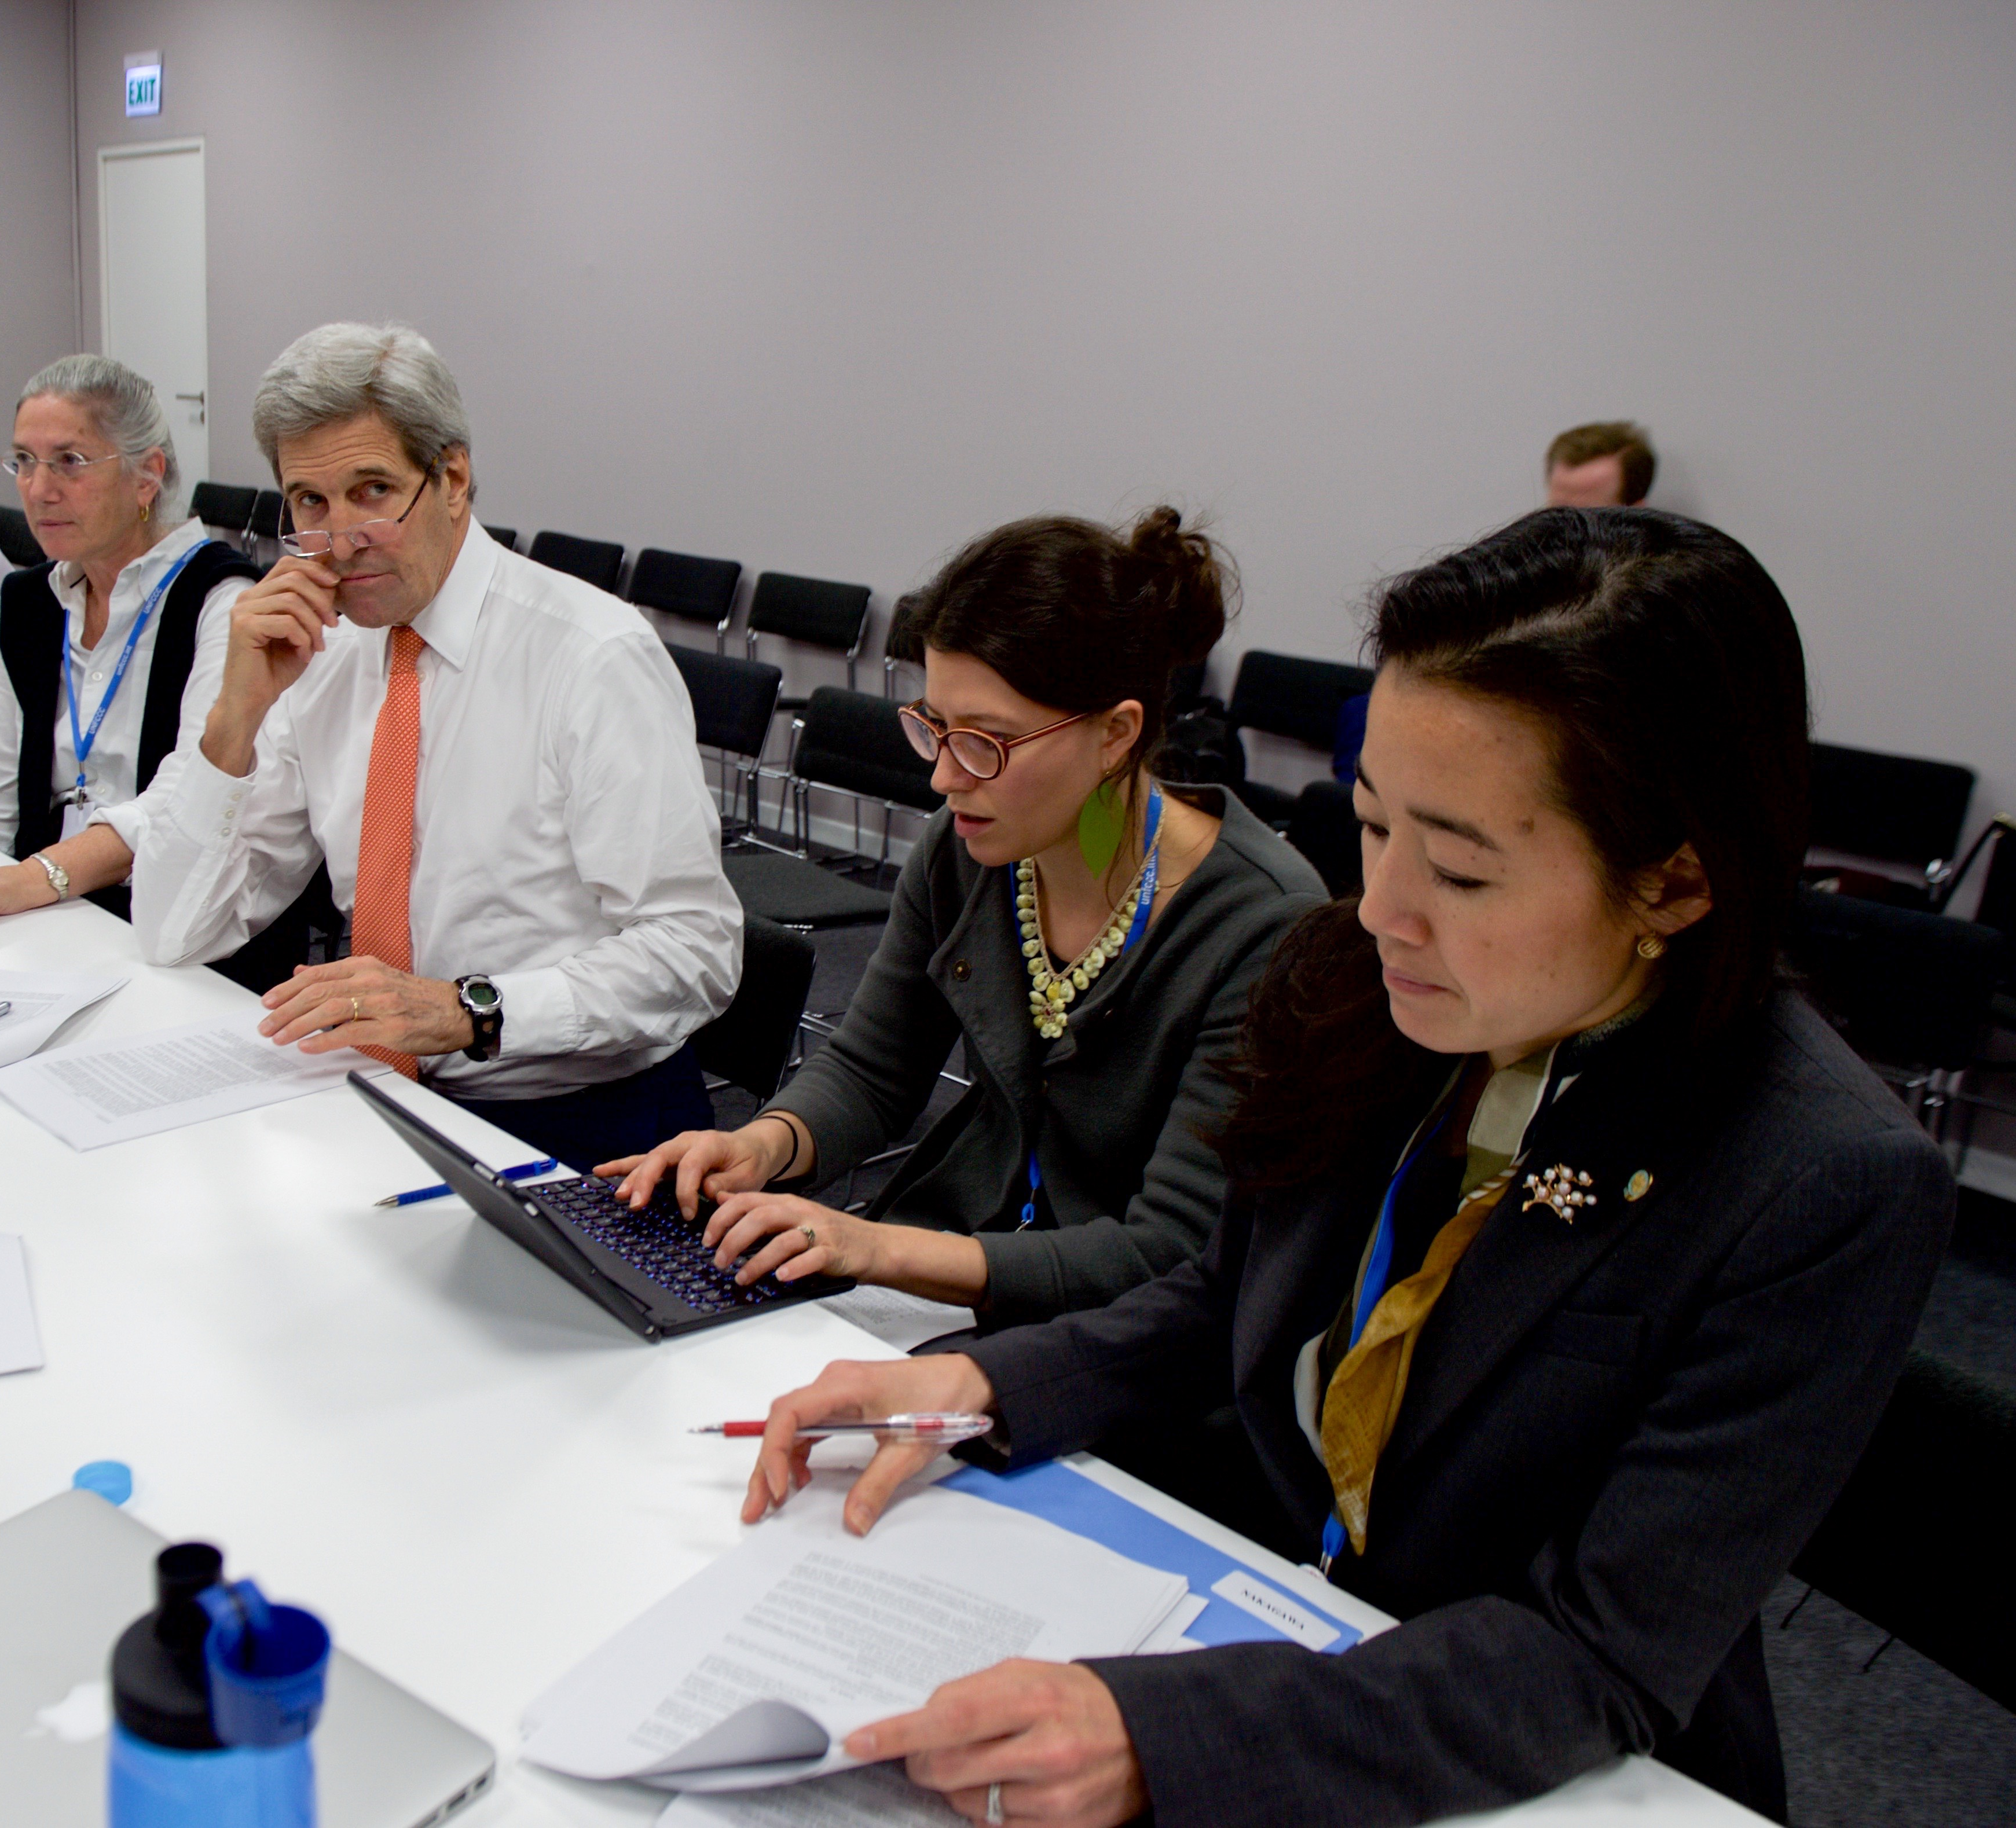
Note #1
Not everyone is easy to work with.
A little patience can go a long way in making your teams more effective.
We’ll talk about dealing with difficult people and situations more next class (“Talking Good”).
Notes:
Image from commons.wikimedia.org

Slide 17
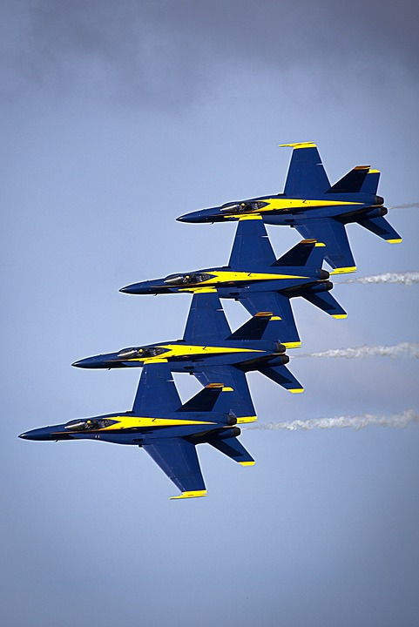
Note #2
Synergy is a learned skill for groups.
If your group isn’t performing up to the level you want it to, give it time— sometimes a little more practice is all you’ll need.
Notes:
Image from pixabay.com

Slide 18
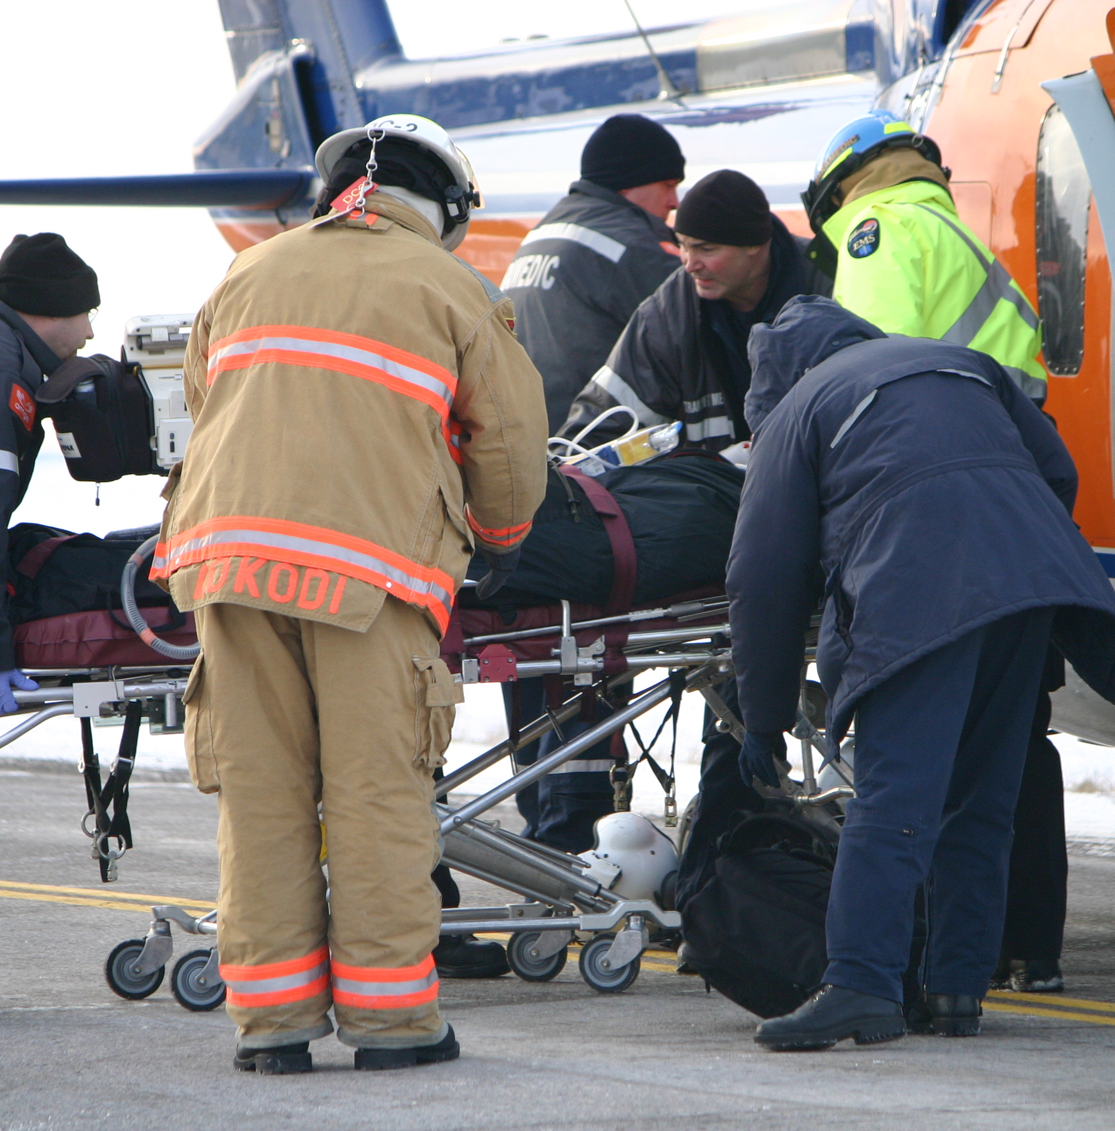
Note #3
Learn what each member does well, and use it.
Everyone has different strengths. Learn your team members’ strengths, and you’ll be in great shape. (We’ll talk about this more in class #8.)
Notes:
Image from en.wikipedia.org

Slide 19
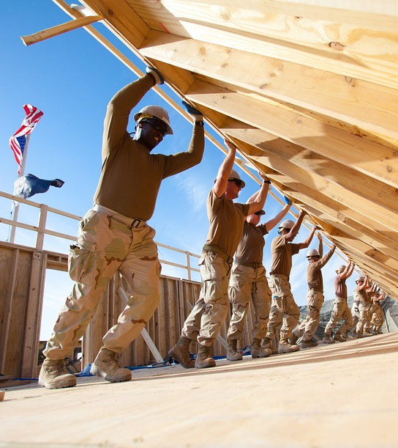
Reflect
There’s more to learn about being a good team member, but you’ll learn more as you go
Any thoughts on synergy and teamwork?

Slide 20
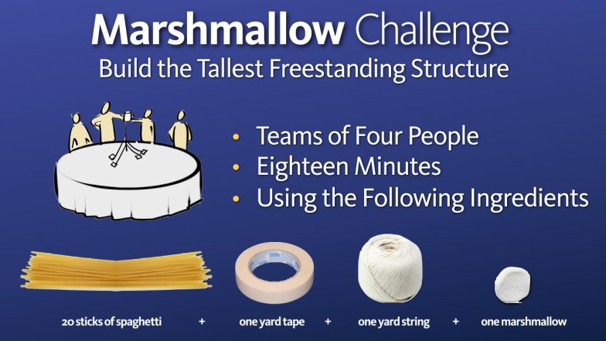
Notes:
This activity is optional, and could take 10-18 minutes (take as long as you have). Most students have probably done something similar in physics class.
Depending on the number of students, groups could be 3-4 students
Be sure to allow 7-10 minutes for the video (next slide) and wrap up
http://www.tomwujec.com/design-projects/marshmallow-challenge/

Slide 21
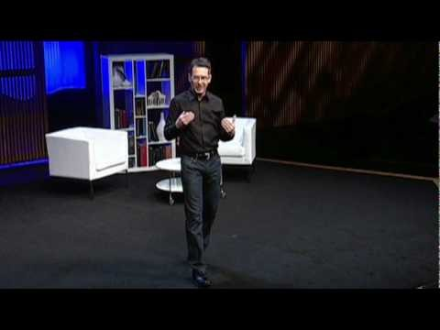
Notes:
6:46
The video may take a minute to load
Source: https://www.youtube.com/watch?v=H0_yKBitO8M

Slide 22

Challenge
Become an exceptional team player!
No matter how brilliant you are, you will never be as successful alone as you can be with a team.
Employers want and will pay for good team members!
Notes:
Image from www.global-collaborations.com

Slide 23
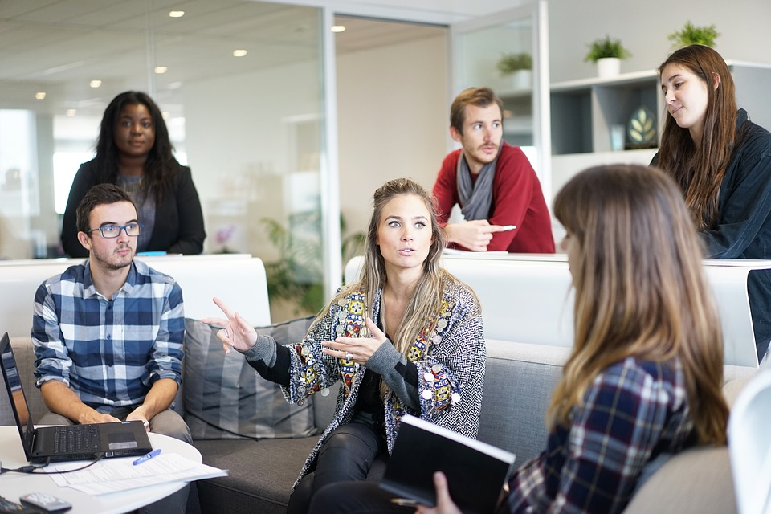
HW
Think about which teams you’ve been on, or are on now.
How can you be a better team-player?

Slide 24
Review
Objective
Learn importance and application of principles of synergy

Slide 25
Additional Resources
https://www.youtube.com/results?search_query=teamwork+ted+talk&page=&utm_source=opensearch
http://www.tomwujec.com/design-projects/marshmallow-challenge/
https://www.ted.com/talks/margaret_heffernan_why_it_s_time_to_forget_the_pecking_order_at_work?language=en
https://www.ted.com/talks/howard_rheingold_on_collaboration?language=en
https://www.ted.com/talks/steven_strogatz_on_sync

Slide 26
Content (not images or videos) copyright information:

